Slide 1

Making Changes to Existing Name and Work/Expression Authority Records
Module 7
Module 7. Making Changes to Existing Name and Work/Expression Authority Records
Notes:
May 16, 2024: changed module number from 8 to 7
Note to presenters: The examples used in this presentation are modified from existing NACO records in the LC/NACO Authority File. The module developer wanted to show existing authorized access points and 670 information. However, some changes were intentionally made to the records (using a local copy of the records) for instructional purposes. Please tell attendees that the live records in the NACO node databases were not changed, and there is no correlation between the records in this module and the records in the NACO database.

Slide 2
Overview
You now know how to create a “perfect” RDA authority record!
You now know to search thoroughly to find the authority record you need
But …
Module 7. Making Changes to Existing Name and Work/Expression Authority Records
Notes:
May 1, 2013
You now should know how to create a “perfect” RDA authority record. The training you have taken has given you all you need to know to do this.
You also know the importance of searching first, to see if the entity you need has already been established by another NACO colleague who is as well-trained as you are.
But … (next slide)

Slide 3
It is Not a Perfect (NACO) World
The training prepared you to create NEW NACO records and to SEARCH for existing NACO records
But you will not always be creating new NACO records
And you will not always find the perfect existing NACO record
Module 7. Making Changes to Existing Name and Work/Expression Authority Records
Notes:
May 1, 2013
In reality, the NACO work you do in the future will often involve working with existing NACO records. And those existing NACO records will not always be up to the high standards that you have.
On the next slide, let’s look at the steps you will go through every time you are cataloging with NACO in mind.

Slide 4
Summary: Basic Principle
Authority records must conform to RDA practices!
Remember 008/10 Rules = z
Remember 040 subfield $e rda
Module 7. Making Changes to Existing Name and Work/Expression Authority Records
Notes:
May 1, 2013
The basic principle is that every NACO authority record you create will be coded RDA (Rules 008/10 = z and 040 subfield $e = rda). This is just the basic coding of the record. Of course, the data added to a new record will vary from cataloger to cataloger– cataloger’s judgment, in other words.
But what about existing NACO authority records. Will they always be coded RDA? Will you need to do something if you encounter a non-RDA NACO authority record that you need for a resource in hand? More on that later in the session.

Slide 5
Summary: Checklist
You need an access point for a bibliographic record, so:
  Search multiple forms of the name
  Search both bibliographic and authority databases
  Sometimes research is needed to clarify relationships
  Remember the 24-hour rule
  Don’t overdo it!
Module 7. Making Changes to Existing Name and Work/Expression Authority Records
Notes:
May 1, 2013
Some authority records are made that do not have any direct relationship to a bibliographic record. For example, if you need to create a parent body NAR in order to have the required cross-references for a corporate body, that parent body may not appear on any bibliographic record.

Slide 6
Summary: Search Results Govern Workflow
Module 7. Making Changes to Existing Name and Work/Expression Authority Records
You find an NAR -- Use it!
You find an NAR -- Update it!
You do not find an NAR -- Create a new one!
  OCLC Connexion and SkyRiver have authority macros
Notes:
May 1, 2013
Searching is extremely important. Your good searching will result in your confidence in taking appropriate action:
You search and find a NAR for the entity you need. Great! The authorized access point is based on the preferred name that is used in the resource you have in hand. The cataloger has done an excellent job of adding attributes to the existing authority record. There are no new name usages, and no new attributes, identified in the resource you have in hand. All you need to do is use the authorized access point in the bibliographic record you are creating or reviewing, and you are done.
You search and find a NAR for the entity you need. Great! But in this case, for example, you note that the resource you have in hand has a different usage of the name. Or perhaps you can identify attributes in the resource in hand that might enhance the existing authority record. The authorized access point likely will not need to change, but you would like to update the existing authority record to add variant names or new attributes. Please remember that an existing NACO authority record that is not as “full” as you would like is not a reflection on the cataloger that created it. You can always add to the record.
Your thorough searching results in no authority record for the entity you need. Perfect world! You create a new NACO authority record.

Slide 7
Summary: Search Results Govern Workflow
You find a NAR -- Update it!
Let’s look at some typical cases– sometimes an update is optional, and sometimes it is required
Module 7. Making Changes to Existing Name and Work/Expression Authority Records
Notes:
May 1, 2013
In the previous slide, you saw three possible outcomes as a result of your searching. The first outcome-- You find a NAR -- Use it! – is perhaps the easiest. You make no changes to the existing record. The third outcome -- You do not find a NAR -- Create a new one! – is more involved time-wise, but it gives you an important task– to set up a new authority record. This is the “perfect world” scenario – everything you learned in this training is put to the test.
But the second outcome -- You find a NAR -- Update it! – has all sorts of options. The rest of this module will assist you in deciding what you can do with an existing NACO authority record, and what, in some cases at least, you must do to an existing NACO authority record.

Slide 8
Why Update an Existing NAR ?
To enhance it by adding new attributes or new variant access points that assist the catalog user
To change an existing variant access point to resolve a NACO conflict
To change an existing authorized access point to resolve a NACO conflict
To change an authorized access point to close an open birth date, or to add a birth date to an authorized access point containing only a death date
Notes:
May 1, 2013
Although NACO work may appear to be all about creating new, unique authorized access points, the truth is that NACO catalogers usually find themselves in the position of updating an existing NACO record.
A change to an existing NACO record may involve adding new information or changing existing information.
What are some of the common situations in which a NACO cataloger will contemplate updating – or may be required to update -- an existing NACO record?
(Text from slide: examples and further explanations follow on succeeding slides)

Slide 9
Why Update an Existing NAR ?
To consolidate information when a duplicate NAR will be reported for deletion
To evaluate and re-code an existing AACR2, AACR2-compatible, or earlier rules NAR that is not RDA-acceptable to RDA
To evaluate and re-code an existing RDA-acceptable AACR2 NAR to RDA
To correct an RDA authorized access point “error of fact”
Notes:
May 1, 2013
(Text from slide: examples and further explanations follow on succeeding slides)
2nd bullet: To evaluate and re-code an existing AACR2, AACR2-compatible, or earlier rules NAR that is not RDA-acceptable to RDA:
In most cases, the 1XX will change.
3rd bullet: To evaluate and re-code an existing RDA-acceptable AACR2 NAR to RDA:
Even in this case, the 1XX might change! It is important to analyze all authority records before re-coding them to RDA!

Slide 10
To Enhance by…
Changing or updating attributes, for example:
  Dates (046 field)
  Associated Places (370 field)
  Address (371 field)
  Field of Activity (372 field)
  Profession/Occupation (374 field)
  etc.
Module 7. Making Changes to Existing Name and Work/Expression Authority Records
Notes:
March 6, 2020: changed caption of third bullet (from Locations to Associated Places)
Examples follow.

Slide 11
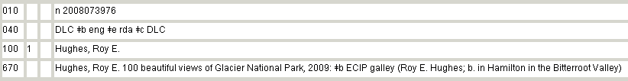
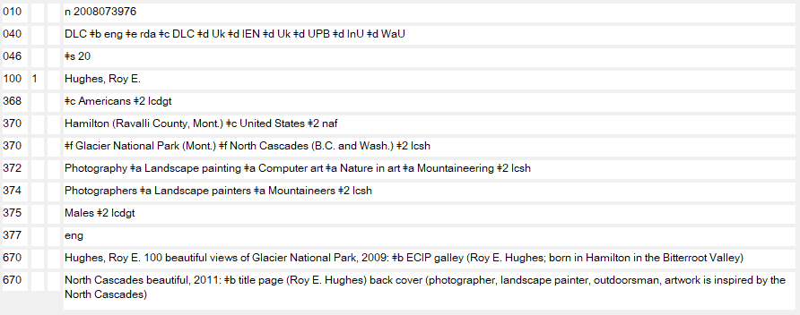
Changing or Updating Attributes
--------
Module 7. Making Changes to Existing Name and Work/Expression Authority Records
Notes:
May 16, 2024: whited out the gender field
March 7, 2019: updated NAR
This is an existing RDA authority record. Note that there is nothing more than the preferred name recorded in the 1XX. The absence of dates or a fuller form of the initial E., and the lack of a NACO conflict with another Roy E. Hughes, result in the preferred name being identical to the authorized access point.
However, the cataloger now has a new resource that needs a bibliographic access point for the person. The resource in hand has new attributes for the person. The cataloger adds these attributes to the authority record. The authorized access point remains unchanged, though.
Note that the name usage in the resource being described is identical to the existing usage used to identify the preferred name. Because of that, the cataloger could have left this record unchanged, but the optional additions here are a good enhancement.

Slide 12
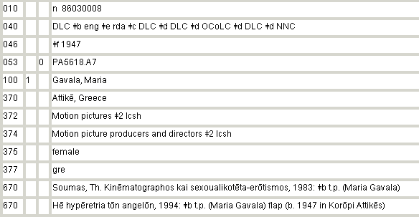
Adding Variant Access Point(s)
Module 7. Making Changes to Existing Name and Work/Expression Authority Records
Notes:
May 1, 2013
Here is an existing NACO authority record. The authorized access point discovered in searching is needed as an access point in a bibliographic record. But the cataloger has identified a variant non-Latin name in the resource being described. The cataloger would like to add the non-Latin variant to the existing NAR. (Next slide)

Slide 13
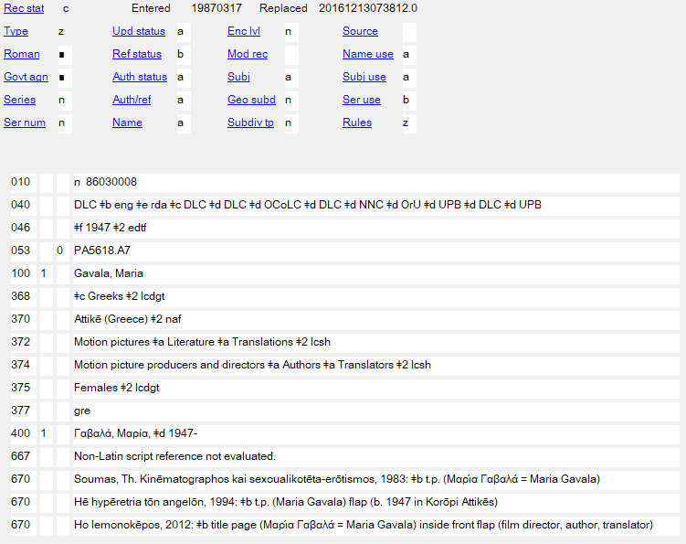
Adding Variant Access Point(s)
________
Module 7. Making Changes to Existing Name and Work/Expression Authority Records
Notes:
October 11, 2024: kept 375 from previous slide but showed that it gets deleted when revising
January 23, 2023: removed gender
February 6, 2019: updated to show current version of the authority record and to explain more fully what’s going on.
The cataloger initially intended to add a non-Latin variant. The red arrows point to the additions and changes that were needed to do this: Ref status had to be changed from “n” to “b”; the variant added in 400; and the 667 note for non-Latin script reference was added; and a 670 for the resource in hand was added justifying the addition of the variant (remember guidelines on justification).
While in the record the cataloger made either RDA-related additions or changes to RDA elements already in the record (to reflect current policy). These are shown by the black arrows. The cataloger revised 046 (revised to EDTF form and coding), and 370 (revised to controlled form); the cataloger added or made additions to 368 (other designation associated with person element, in this case, the person’s nationality); 372 (added a few more field of activity elements); 374 (added a few more profession or occupation elements). The justification for these new additions is found in the new 670.
The 375 gender field was also deleted, because current PCC policy is not to record gender in this field and to remove 375 fields when a record is being revised for any other reason.

Slide 14
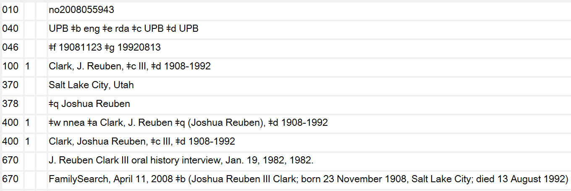
Showing New Relationship(s) Between Entities in 5XX fields
Module 7. Making Changes to Existing Name and Work/Expression Authority Records
Notes:
Updated September 4, 2019: moved $w nnea in 400 to the front of the field.
Here is an existing NACO authority record. The authorized access point is needed in the cataloging of a new in-hand resource. As in the previous example, new information not related to the 1XX itself, is identified. (Next slide)
Note: the AACR2 heading for this person was:
100 1 Clark, J. Reuben $q (Joshua Reuben), $d 1908-1992
Because there was no subfield $c in the AACR2 heading, and no abbreviations (b. or c. or fl., etc.) in the heading, this record was not flagged for cataloger analysis at the time of re-coding to RDA. However, the AACR2 heading was not acceptable under RDA because of the relationship term III that was not a part of the AACR2 heading. The cataloger noticed this at the time of the re-coding to RDA (see the 670 fields showing usage of the name with III); the RDA preferred name that was used as the basis of the authorized access point is: Clark, J. Reuben, III

Slide 15
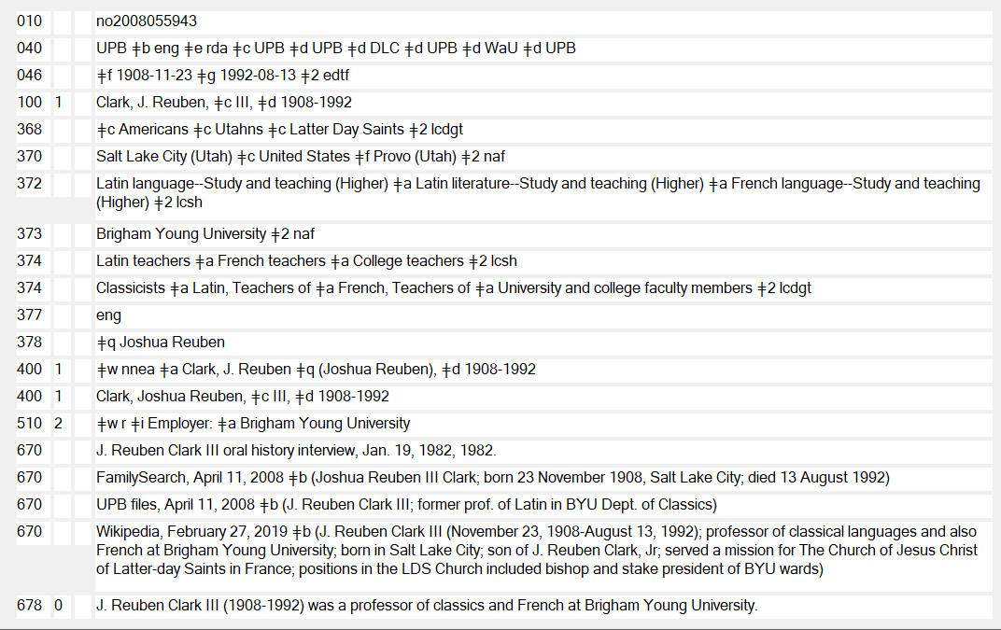
Showing New Relationship(s) Between Entities
Notes:
May 28, 2024: replaced record to correct 368 form and remove gender field
March 7, 2019: replaced image of record to show current version with 368
This existing NACO authority record was enhanced by the addition of many new elements, as identified above with the arrows, and an update of the 046 field. But perhaps the most important addition is the 5XX relationship that is described between the person and his employer, Brigham Young University.

Slide 16
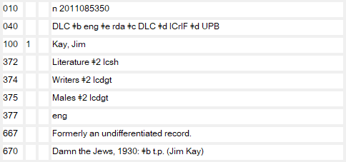
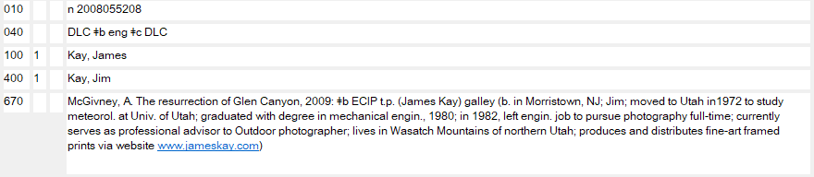
To Change an Existing Variant Access Point to Resolve a NACO Conflict
Module 7. Making Changes to Existing Name and Work/Expression Authority Records
Notes:
March 7, 2019: replaced made-up record
Here is a situation in which you may add information to an existing variant access point in order to break a conflict with a new authorized access point being established.
You are establishing the name Kay, Jim, based on the resource Damn the Jews. However, the resource offers you very little in the way of identifying characteristics– no dates, no fuller forms, no occupation (other than Author).
The lack of identifying characteristics is noteworthy because there is a NACO conflict between the authorized access point you are establishing, and a variant access point in another record.
Fortunately, there are more identifying characteristics available in the existing NACO record, and one of those, Photographer, can be used in the variant access point to break the NACO conflict. See the next slide for the updated record.

Slide 17
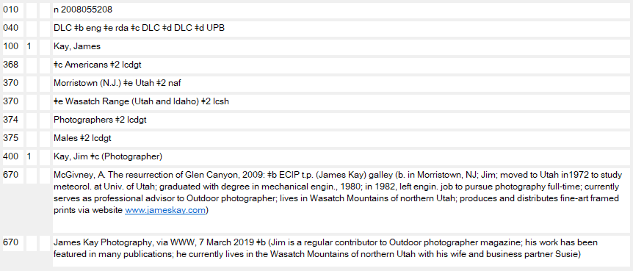
To Change an Existing Variant Access Point to Resolve a NACO Conflict
Module 7. Making Changes to Existing Name and Work/Expression Authority Records
Notes:
May 16, 2024: whited out the gender field
March 8, 2019: replaced made-up record
Here is the updated NACO record. The Profession/Occupation (Photographer), which we know is appropriate from the 670 fields can be used in the variant access point to break the conflict. The cataloger also added other new RDA elements

Slide 18
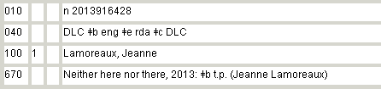
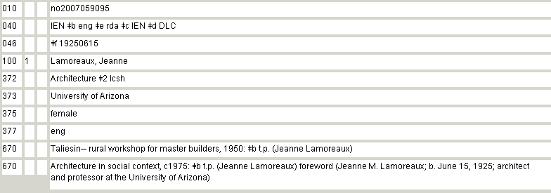
To Change an Existing Authorized Access Point to Resolve a NACO Conflict
Notes:
May 1, 2013
Often a NACO cataloger may encounter a situation where a new authorized access point being established conflicts with an existing authorized access point, but although there may be no distinguishing characteristics available for the name being established, there might be distinguishing characteristics already in the existing NACO record in conflict. This is similar to the situation we just looked at, although in this case, we are going to have to change an existing authorized access point, even though it does not have an error. Short of making this an undifferentiated name authority record, there is no other solution here, since two different NACO authorized access points cannot normalize to the same form.
In the slide above you see a new authorized access point being established: Lamoreaux, Jeanne, based on the work Neither here nor there. This person’s name may have appeared in a long list of creators or collaborators on the title page, and you want to create a NACO record for each of them. It is very difficult to determine any dates associated with this person, there are no fuller forms of name, and it is very hard to determine a profession or an occupation.
This would not be a problem if there were no conflict, but there is a conflict with an existing established authorized access point with the same preferred name Jeanne Lamoreaux. Note that that record had additional identifying characteristics added based on a publication that was not in print at the time the authority record was created.
We have a 1XX to 1XX conflict, and it must be broken. We can use one of the identifying characteristics from the existing record to break the conflict in that existing record.

Slide 19
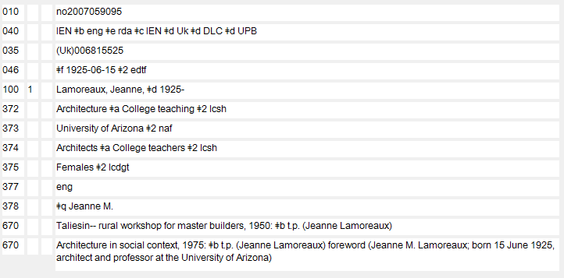
To Change an Existing Authorized Access Point to Resolve a NACO Conflict
Module 7. Making Changes to Existing Name and Work/Expression Authority Records
Notes:
January 23, 2023: remove gender
Updated December 14, 2016
Here is the updated NACO record. The date of birth that was added to the second 670 in the existing record can be used in the authorized access point to break the conflict!
If that date of birth had not been available, we had other options to break this conflict: 1) the fuller form $q (Jeanne M.) or the addition of the profession $c (Architect)
This existing NACO authority record was also enhanced by the addition of new elements, as identified above with the arrows, and an update of the 046 and 373 fields.
This is a 1XX change. Would you report BFM? (Answer: not necessary since the change is a 1:1)
It is a good idea, in fact, a NACO requirement, to search for other authority records that use this name as an element. Those will need to be updated as well. In this case, there may be a work title or an expression title that includes this creator’s name in the authorized access point. You will need to make changes there, too, to assure that the authorized access point is updated to use the revised 1XX form here.
Remember, anytime a change is made to a 1XX– it makes no difference what the change is– you must search to see if any other 1XX authorized access points are affected by the change. Also remember that a 1XX may appear as a 5XX in another authority record. Those 5XXs will need to be updated as well.

Slide 20
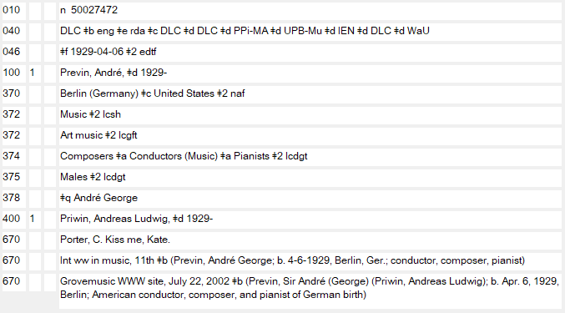
To Change an Authorized Access Point to Close an Open Birth Date
Module 7. Making Changes to Existing Name and Work/Expression Authority Records
Notes:
March 7, 2019: replaced made-up example
Because changing an existing authorized access point has an impact on Bibliographic File Maintenance (BFM), there is a long-standing NACO practice to leave an existing authorized access point alone, unless it has an egregious error.
However, there are two exceptions to that practice that NACO members may apply.
When an existing authorized access point for a person has an open birth date, and a death date has been identified, the authorized access point may be updated to include the death date.
When an existing authorized access point for a person has an open death date, and a birth date has been identified, the authorized access point may be updated to include the birth date. This one is new to NACO, since NACO RDA guidelines instruct you to use a hyphen before a death date in all cases, even if a birth date is not in the authorized access point.
Remember, these updates may be made only if there is already an open birth date, or an open death date, in the authorized access point. You cannot add dates to an authorized access point under this exception if there are no dates in the authorized access point to begin with. You can only add a date to an existing authorized access point lacking dates if the date is needed to break a conflict.
The slide shows an existing NACO record for an open birth date. On the next slide, you will see new information has become available.

Slide 21
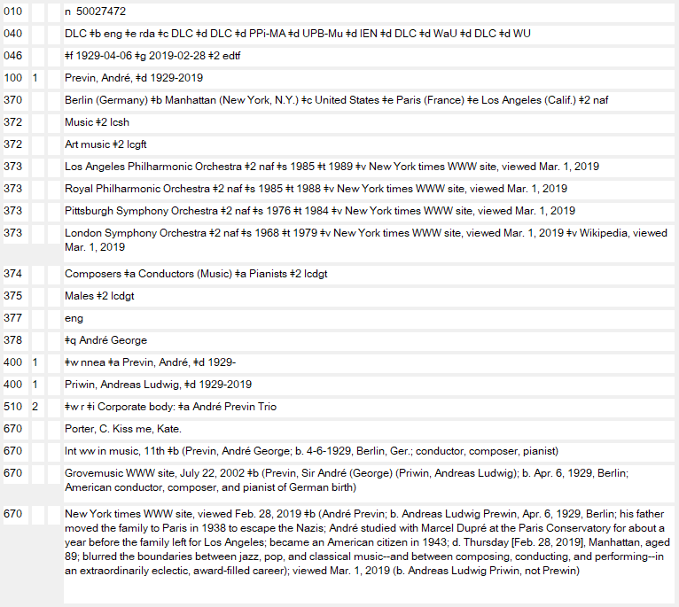
To Change an Authorized Access Point to Close an Open Birth Date
_______
Module 7. Making Changes to Existing Name and Work/Expression Authority Records
Notes:
October 11, 2024: showed deletion of 375 field through a strikeout on the slide
March 7, 2019: replaced made-up example
New information – a death date – has come to light. The NACO cataloger applied the option to add that death date to the existing authorized access point. Note that the cataloger kept the old form in a 400 field coded $w nnea. This is not currently required, as best practices continue to evolve. The cataloger also added some additional information to the NACO record at the same time: 046 death date information, and 370 place of death information, as well as other places associated with Previn. Because in addition to his work as a conductor and composer he created work using English, the cataloger added the language of person element; the cataloger also added a relationship to a musical group he was associated with, the Andre Previn Trio. These are good enhancements to the record. Per PCC policy, the gender field 375 was also deleted.
(We will not look at an example of adding a birth date to an open death date in an authorized access point, but the same principles apply in that situation).

Slide 22
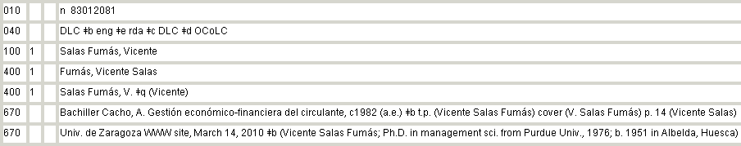
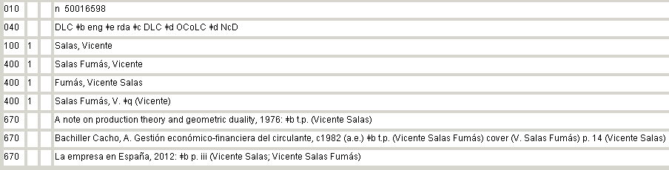
To Consolidate Information in an Existing NAR when a Duplicate NAR Will be Reported for Deletion
Notes:
March 11, 2014
NACO members may encounter duplicate records in the LC/NACO Authority File. A duplicate may be encountered in the process of setting up a new name, or in the process of adding information to an existing authority record. In the case above, the cataloger identified two records for the same person, and following NACO parameters, the cataloger will make a delete request to the Cooperative Programs Section at the Library of Congress. But often there will be information in the record that is to be deleted that would make a useful addition to the retained record.
In the case above, the cataloger who established the authorized access point Salas Fumás, Vicente (n 83012081 ) should have realized that the name was already a variant access point in the record for Salas, Vicente (n 50016598 ). That record n 50016598 should have been used. Instead, there is a duplicate record in the database, but with a different authorized access point.
Either record can be reported for deletion. In this case the cataloger discovered that this person identifies himself on his CV as Salas Fumás, Vicente, indicating that the form with the compound surname is his preferred name. So the cataloger will retain n 83012081, reporting n 50016598 for deletion, even though n 50016598 is the earlier record. See the next slide for the updated NAR.

Slide 23
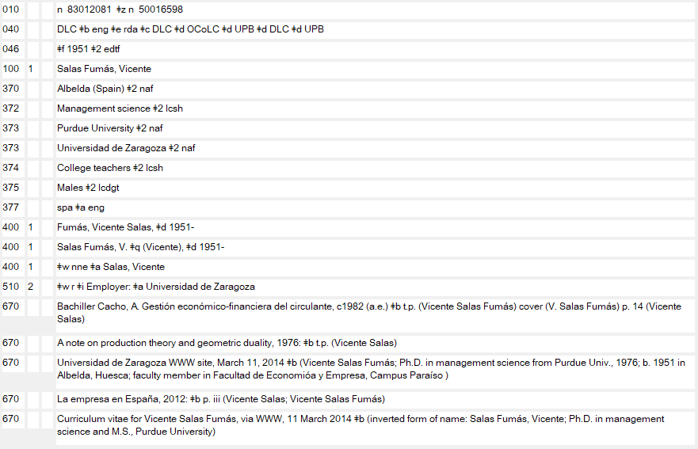
To Consolidate Information in an Existing NAR when a Duplicate NAR Will be Reported for Deletion
Notes:
October 11, 2024: whited out the 375 field
December 17, 2019: updated record view
Here is the updated record to be retained: the 670 fields from the record to be deleted have been moved, and 670 fields for new information have been added. The authorized access point form in the record to be deleted is moved to the record to be retained with coding $w nne (because it was a previously-authorized form. The cataloger added some additional RDA attributes as well. Note that the date of birth was not added to the authorized access point! NACO authorized access points are changed only in a few cases– you have already seen two cases in the preceding examples. However, the cataloger added the date of birth to the variant access points, a practice that is not required but permitted.
Would you report BFM here? (Answer: yes, since a record is being deleted.)

Slide 24
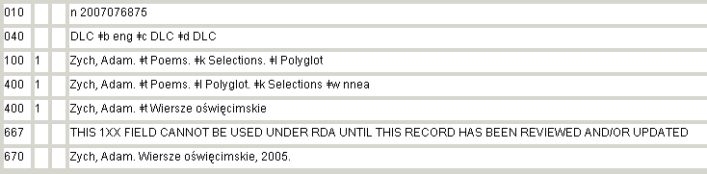
To Evaluate and Re-code an Existing AACR2, AACR2-Compatible, or Earlier Rules NAR to RDA when the 1XX is not RDA-Acceptable
Summary of Programmatic Changes to the LC/NACO Authority
File: What LC-PCC RDA Catalogers need to know
Module 7. Making Changes to Existing Name and Work/Expression Authority Records
Notes:
Updated April 5, 2018
During the transition from AACR2 to RDA, many changes, both automated and manual, took place in the LC/NACO Authority File. One subset of AACR2, AACR2-Compatible, and Earlier Rules NARs was marked by machine with a 667 field that read:
667 THIS 1XX FIELD CANNOT BE USED UNDER RDA UNTIL THIS RECORD HAS BEEN REVIEWED AND/OR UPDATED
(Hyperlink in the slide leads to a document that was used by PCC members during the RDA transition– trainers please go over this document, even if only for historical perspective).
This field was added to those records because the 1XXs were likely incompatible with RDA. Catalogers using these records were required to evaluate and re-code the records to RDA. Often this would only entail a coding change– if the 1XX was RDA-acceptable– to the 008/10 Rules byte and the addition of a subfield $e rda to the 040. But in many, if not most, cases, RDA-trained catalogers needed to change the 1XX to make it RDA acceptable.
Over time, all the records with the 667 note will be evaluated and re-coded to RDA, but if you encounter one of these records, you need to take appropriate action.
In the record on the screen, we have an example of an AACR2 conventional collective title that was marked by machine with a 667 field that read:
667 THIS 1XX FIELD CANNOT BE USED UNDER RDA UNTIL THIS RECORD HAS BEEN REVIEWED AND/OR UPDATED
on account of the presence of the word “Polyglot” in the heading. Polyglot is an AACR2-type word that was used when multiple languages were present in a resource. Under RDA, unique access points are used for each language of an Expression. Although cataloger’s judgment plays a role in how many access points are added to a bibliographic record, one access point cannot contain more than one language of Expression.
According to the “Summary of Programmatic Changes to the LC/NACO Authority File: What LC-PCC RDA Catalogers need to know” document:
Authority records with 1XX fields that contain Polyglot in subfield $l: any AACR2 authority record with polyglot in $l will be labeled with a 667 field as needing review under RDA (fewer than 700 authority records).
What an RDA cataloger should do: If an authority record with $l Polyglot is encountered, and the cataloger can determine which languages were covered by the ‘polyglot’ designation, create substitute RDA authority records for each required language expression covered by the ‘polyglot’ authority record if they don’t already exist (they often will) and report the authority record with $l Polyglot for deletion. If the cataloger can’t determine all of the languages covered by the ‘polyglot’ record, they should create only as many records as they need for the resource they are cataloging, if they don’t already exist. In this case, don’t report the original ‘polyglot’ record for deletion or remove the 667 field.
Note that this record was run through Phase Two of the re-coding of the LC/NACO Authority File and the order of the subfields $l and $k were re-aligned since Selections is a “Work” attribute and must precede Language (an Expression attribute). But the automated changes were unable to substitute the correct language forms, so the 667 note remained in the record.

Slide 25
To Evaluate and Re-code an Existing AACR2, AACR2-Compatible, or Earlier Rules NAR to RDA when the 1XX is not RDA-Acceptable
Module 7. Making Changes to Existing Name and Work/Expression Authority Records
Notes:
May 1, 2013
The AACR2 record needs to be deleted in favor of the individual authorized access points for the three languages represented by “Polyglot” in the AACR2 heading. Those languages are Polish, German, and English.
Separate RDA authorized access points will be necessary for the languages the cataloger wished to express in the bibliographic record. See the next slide.

Slide 26
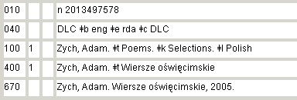
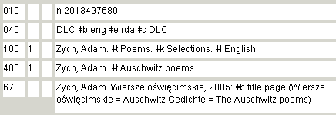
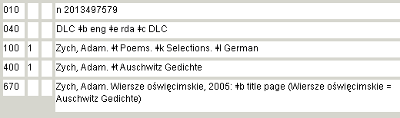
To Evaluate and Re-code an Existing AACR2, AACR2-Compatible, or Earlier Rules NAR to RDA when the 1XX is not RDA-Acceptable
Module 7. Making Changes to Existing Name and Work/Expression Authority Records
Notes:
May 1, 2013
What was one AACR2 authority record resulted in three RDA authorized access points, since the cataloger wanted to add each access point to the bibliographic record. BFM should be reported since the AACR2 authority record was deleted and there is no 1:1 link between that record and these new ones.
An added complication (but not mentioned in the slides) was that the creator’s authority record was still coded AACR2. In order to avoid a “hybrid” situation, it was necessary to evaluate and re-code the authority record for Zych, Adam (n 85083965) to RDA as well before proceeding with the changes described above.

Slide 27
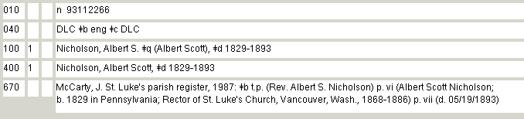
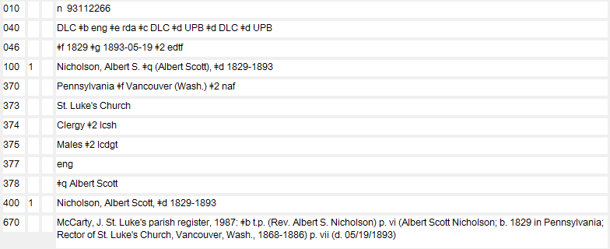
To Evaluate and Re-Code an Existing RDA-Acceptable AACR2 NAR to RDA
Notes:
October 11, 2024: whited out the gender field (looks better than blacked out)
May 16, 2024: blacked out the gender field
Updated September 4, 2019: corrected grammatical error in notes
Most of the existing AACR2 headings in the LC/NACO Authority File are acceptable under RDA with no change to the 1XX. NACO catalogers can optionally re-code these records to RDA, or may be required to re-code them in certain cases–for example, if you are adding a new variant or an RDA attribute, in other words, if you are “working” with the authority record, you may have to re-code it to RDA. LC/PCC policy requires that catalogers who make any change to a NAR are required to re-code it to RDA.
We’ll look at two personal names and a corporate name here.
In the example above, the AACR2 heading is acceptable as an RDA authorized access point. Note that there is a subfield $q fuller form in the AACR2 heading. This addition was required under an Option in AACR2 (NACO applied that option). Under RDA, however, at least in NACO policy, the fuller form is optional if there is no conflict and if the cataloger feels the addition of the fuller form assists in the identification of the person.
Because the fuller form was already present in the AACR2 heading, there is no need to evaluate it now for its usefulness. The fuller form is RDA acceptable and the record may be re-coded to RDA with no change to the 1XX. The cataloger optionally added RDA attributes to other fields in the authority record. These are good enhancements.
Note the 373 field: St. Luke’s Church. This is the preferred name, not the authorized access point (St. Luke’s Church (Vancouver, Wash.)). This is acceptable under RDA. No subfield $2 naf is added since the form is not the authorized access point for the church.
Would you report BFM? (Answer: not necessary since there is no change to the 1XX.)

Slide 28
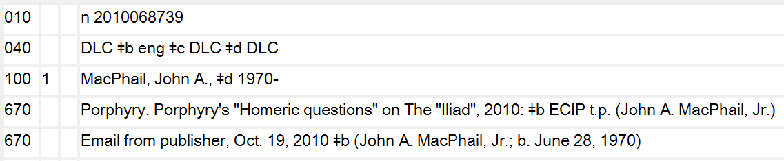
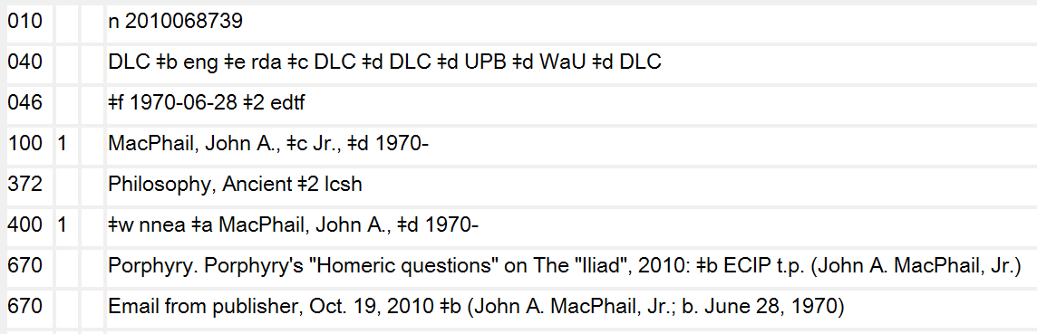
To Evaluate and Re-Code an Existing Non-RDA-Acceptable AACR2 NAR to RDA
Module 7. Making Changes to Existing Name and Work/Expression Authority Records
Notes:
September 4, 2019: moved $w nnea in 400 to front of field; changed 372 to controlled form for Greek philosophy
In the example above, the AACR2 heading appears to be RDA-acceptable. There is no 667 note in the record indicating otherwise, and there is no subfield $c in the AACR2 heading that might not be acceptable under RDA.
So the cataloger would like to re-code this AACR2 record to RDA. But if you look closely at the 670 usages (and you should in every case!) you will see that the AACR2 heading is in fact NOT RDA acceptable. The relationship term Jr. is considered part of the RDA preferred name, so this 1XX will need to change at the time of re-coding to RDA. The cataloger optionally added RDA attributes to other fields in the authority record. These are good enhancements.
Please be very careful with AACR2 records when you re-code them to RDA. Remember, you must evaluate the record before you re-code it! Also note: because of large machine-recoding projects some AACR2 records were recoded as RDA when in fact they are not RDA-acceptable. If you encounter any of these you should revise the authorized access point to an RDA-acceptable form.
Would you report BFM in this case? (Answer: not necessary since change is a 1:1.)

Slide 29
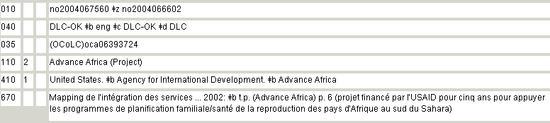
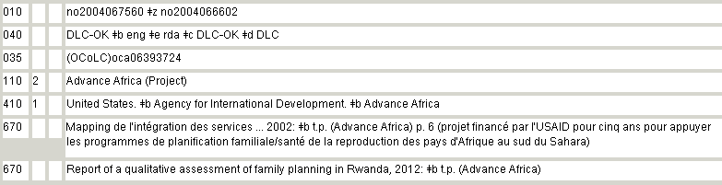
To Evaluate and Re-Code an Existing RDA-Acceptable AACR2 NAR to RDA
Notes:
May 1, 2013
Here is another example--this time it is a corporate name, though. The AACR2 heading is perfectly acceptable as an RDA authorized access point. The cataloger added a 670 field for the resource being described– the addition does not add any new information, however. But the cataloger did decide to apply the option to re-code this AACR2 record to RDA by changing the 008/10 Rules byte and adding the subfield $e rda to the 040.
The cataloger could have added a 368 field for Type of Corporate Body, a 373 for Associated Group (e.g., USAID), and/or a 370 for Associated Place (Africa).
Is there any BFM in this case? (Answer: not necessary since there is no change to the 110.)

Slide 30
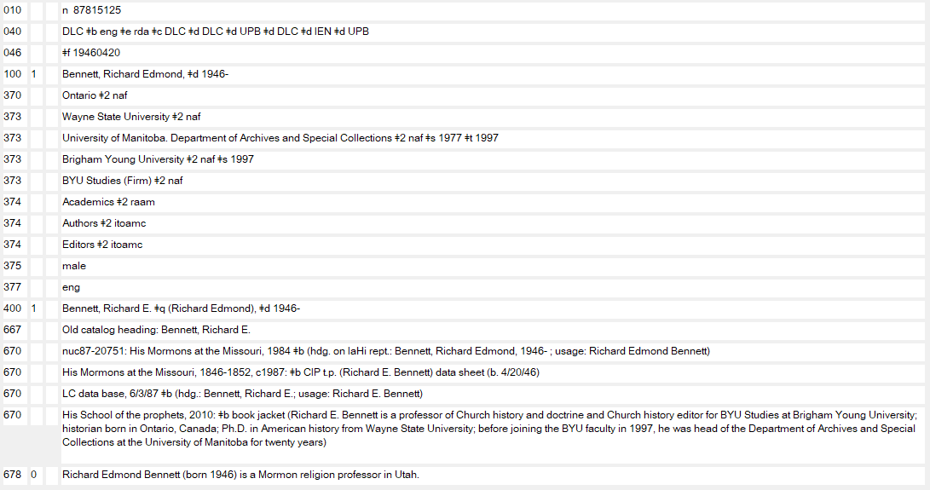
To Correct an RDA Authorized Access Point “Error of Fact”
Module 7. Making Changes to Existing Name and Work/Expression Authority Records
Notes:
March 7, 2019: replaced made up example
What is an RDA “Error in Fact?” It could be an authorized access point that contains an incorrect date– maybe the cataloger made a typo, or it could be an authorized access point that is no longer based on the preferred name– the original record was based on a form that was never used again, and the person is clearly known now by another form.
This slide illustrates the second situation.
Note that the authorized access point was established based on a thesis. Often the fullest form available is presented on a thesis preferred source. The cataloger who established the authority record did nothing wrong.
Along the way, more publications were cataloged, and at one point the AACR2 record was re-coded to RDA. But did the cataloger who re-coded the record to RDA really evaluate the record? What would you say the commonly-known form of name is now? The authorized access point in this case contains an “Error of Fact” and should be changed.

Slide 31
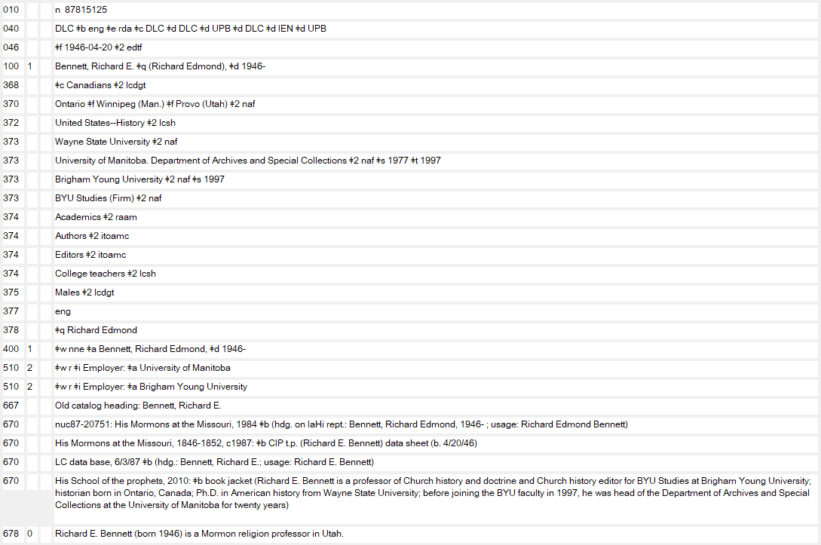

To Correct an RDA Authorized Access Point “Error of Fact”
______
Module 7. Making Changes to Existing Name and Work/Expression Authority Records
Notes:
October 11, 2024: instead of blacking out 375, showed it with a strikethrough
May 16, 2024: blacked out gender field.
September 4, 2019: removed arrow next to 373 Wayne State University
Here is the correct authorized access point. It is based on the predominant usage of the name. Often it is very easy to overlook things like this – NACO catalogers improve records by adding newly-identified attributes or variants, but remember the importance of a thorough review, including evaluating the authorized access point itself, when you are working with a record. The cataloger here, at the same time, added some new RDA elements and updated others, including deleting the 375 field.

Slide 32
What About Linking References?
Make a see reference with $w nnea for the formerly established form of 1XX, unless the reference itself is a valid RDA variant access point, in which case use
$w nne. In case of doubt, use $w nnea.
Notes:
32
September 4, 2019: revised third box in slide
There are times when a 1XX will be changed. We have seen two examples already, on the slide above. When would you code these references, and what coding would you use?
Note in the MacPhail case, the previously-established form is not RDA-acceptable, so it is coded $w nnea when changed to a variant form (so it doesn’t display); in the Bennett example, the previously-established form is an RDA-acceptable form so it is coded $w nne when changed to a variant form (so that it does display).
Please see the Personal Name FAQs 12-13: http://www.loc.gov/aba/pcc/naco/personnamefaq.html for more information on when to record references from former names.

Slide 33
7 Exercises
Module 7. Making Changes to Existing Name and Work/Expression Authority Records
Notes:
33
Updated April 5, 2018: renumbered
The additions made to these records at the time the changes were made are necessary in some cases, and optional in others. That is why the answers are “suggested.” It might be a good idea to ask the attendees to distinguish between what had to change, and what was optionally added or changed.

Slide 34
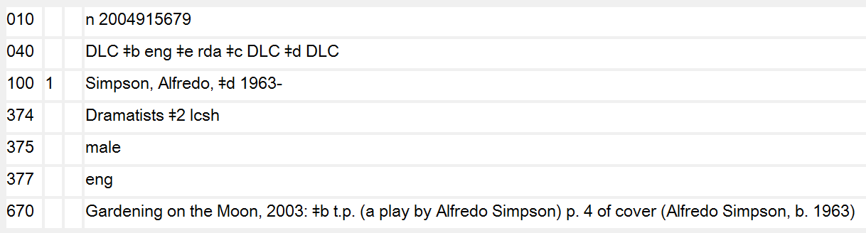
Exercise 1
New resource in hand:
Module 7. Making Changes to Existing Name and Work/Expression Authority Records
Notes:
Updated September 4, 2019: revised LCCN, because DLC records don’t have prefix “no”.
Note to trainer: this is a made-up example.
Are you required to do anything with the existing authority record, if you need this access point in a bibliographic record you are creating for the new resource?
Are there any changes that could optionally be made?

Slide 35
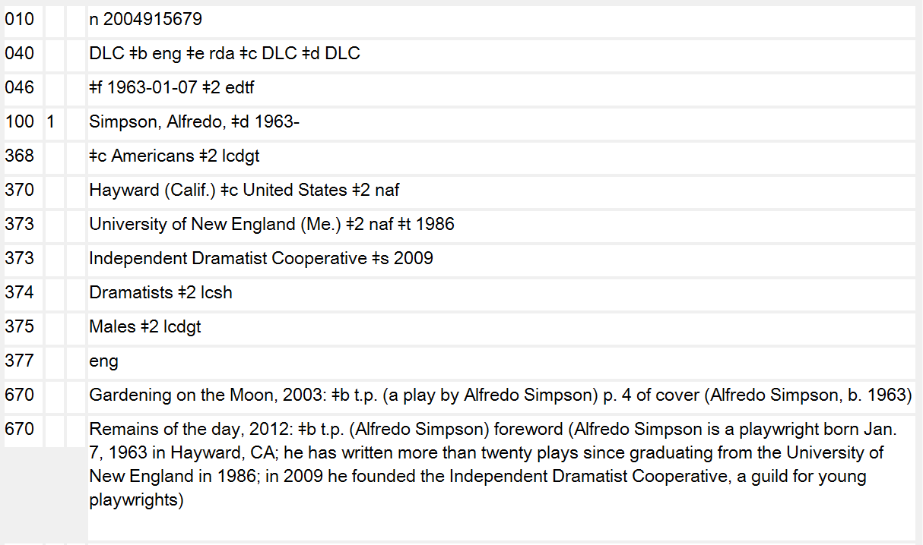
Exercise 1 – Suggested Answer
_________
Notes:
October 11, 2024: showed strikethrough the 375 field
January 23, 2023: remove gender
September 4, 2019: updated slide and notes: added 368 $c, 370 $c, revised first 373, and changed 375 to controlled form
You are not required to do anything with the existing authority record, if you need this access point in a bibliographic record you are creating for the new resource. The name used in the new resource is the same as the name used to create the authority record – usage is consistent as Alfredo Simpson.
But the resource in hand has additional attributes that are an enhancement to the record.
There is a complete birth date (RDA 9.3.2) that can be added to an 046 field.
There is a birth location (RDA 9.8) that can be added to a 370 field. Since he is an American and thus associated with the United States, this information can be added in 368 $c and 370 $c.
There is an affiliation (RDA 9.13) – the University of New England -- that can be added to a 373 field. There is also a date associated with that affiliation that can be added to a subfield $t in the 373 field– Alfredo Simpson graduated from the University of New England in 1986.
There is a possible relationship that can be identified in the new resource. Alfredo Simpson founded the Independent Dramatist Cooperative in 2009. This would be an ideal relationship to record in a 510 field with the relationship designator Founded corporate body of person. But in order to record this relationship, there would need to be an existing authorized access point for the Independent Dramatist Cooperative. There is not an authorized access point for the Independent Dramatist Cooperative. You may consider expressing this relationship instead as an affiliation, in the 373 field. You can record an affiliation for a person even though there is no corresponding authority record for that affiliation– RDA 9.13.1.3 instructs you to record the preferred name for the affiliation– no need to create a separate authority record with an authorized access point in this case.

Slide 36
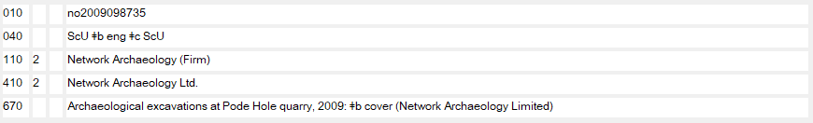
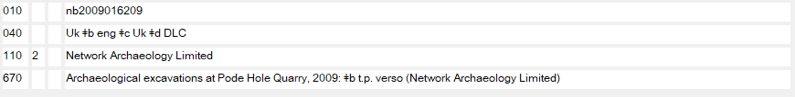
Exercise 2
New resource in hand:
Module 7. Making Changes to Existing Name and Work/Expression Authority Records
Notes:
March 7, 2019: replaced made-up examples with real
You have a new resource in hand and want to code an access point for Network Archaeology, Ltd. But you discover what appears to be duplicate records. Are they duplicates? What happened? Are you required to do anything in this case?
Yes. You need to determine which record should be retained, and which record needs to be reported for deletion. You need to analyze the records. Which one is correct? Are they both correct? If one record needs to be deleted, is there any information that you might want to transfer over to the retained record?

Slide 37
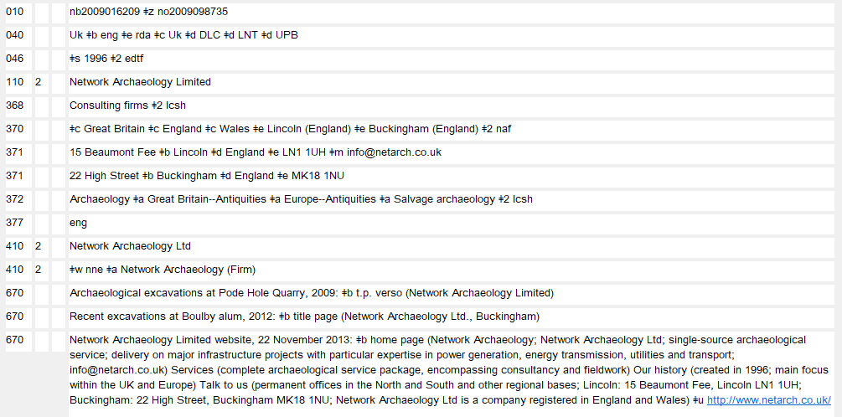
Exercise 2 – Suggested Answer
Notes:
December 17, 2019: added 670 for new resource in hand from previous slide; deleted URL from second $m in 371 field: URLs are not email addresses
Evaluation shows that the preferred name of the corporate body is Network Archaeology, Limited, as on the resource originally being described, and on the organization’s own website. Although RDA 11.2.2.10 says to omit terms indicating incorporation such as Ltd., such terms are not omitted if they are needed to make clear that the name is that of a corporate body. In this case the phrase “Network Archaeology” could be mistaken for a concept--it is not clear that the phrase is the name of a corporate body, and so “Limited” is retained.
So the authorized access point Network Archaeology (Firm) is incorrect and that record should be reported for duplication. The 670 for the organization’s website, though is added to the record to be retained, and note that additional attributes were added to the retained record as well, all based on the website information.
What about that former 1XX, the one that is to be deleted? Is that a valid RDA variant? It is ok to trace the reference, since the name Network Archaeology did appear in a published resource. The addition (Firm) identifies this as a corporate body (RDA 11.13.1.2). So the former authorized access point is an RDA-acceptable variant. The coding $w nne for the variant is appropriate in this case.
Would you report BFM? (Answer: yes, since there is an authority delete involved.)

Slide 38
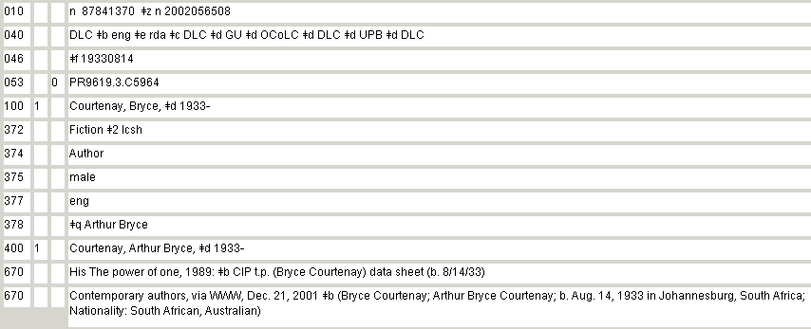
Exercise 3
New resource in hand:
Module 7. Making Changes to Existing Name and Work/Expression Authority Records
Notes:
Updated April 5, 2018: renumbered
You need an access point for Bryce Courtenay, and you find an authority record. But in the resource you have in hand, there is information on the author’s death. Do you need to do anything with the existing record?

Slide 39
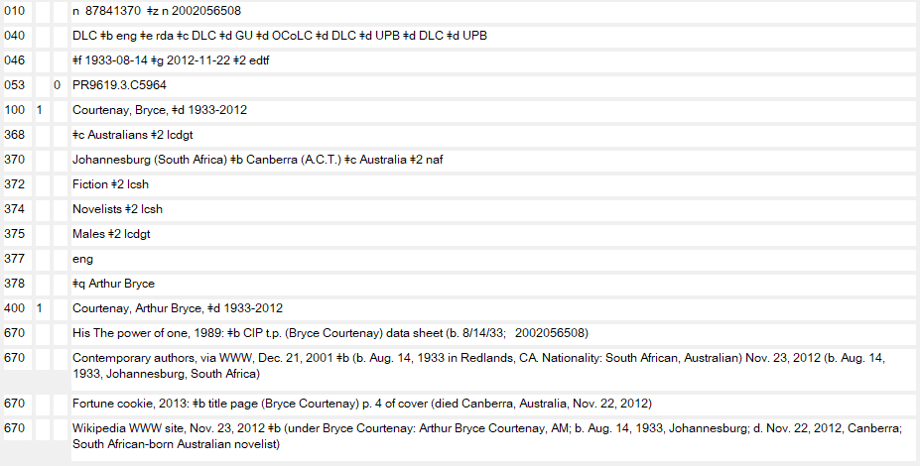
Exercise 3 – Suggested Answer
_______
Module 7. Making Changes to Existing Name and Work/Expression Authority Records
Notes:
October 11, 2024: removed blacked out 375 and instead showed it with strikethrough
May 16, 2024: blacked out gender field
March 7, 2019: updated record
You optionally may add the death year to this open birth date subfield $d in the authorized access point. This is not a requirement, but it is one exception to changing an authorized access point in the absence of conflict or an egregious error.
Would you report any BFM? (Answer: not necessary since the change is a 1:1.)

Slide 40
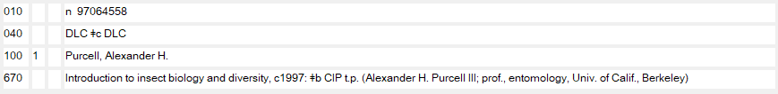
Exercise 4
New resource in hand:
Module 7. Making Changes to Existing Name and Work/Expression Authority Records
Notes:
Updated April 5, 2018: renumbered
Here is a situation where a new resource is in hand and an authority record is found, but if you note carefully, the authority record is coded AACR2. It is “RDA-acceptable” because there is no 667 note indicating otherwise. So a less observant cataloger might accept this AACR2 heading as RDA, and use it in a bibliographic record. But is it really RDA-acceptable? Do you need to do anything to this record?

Slide 41
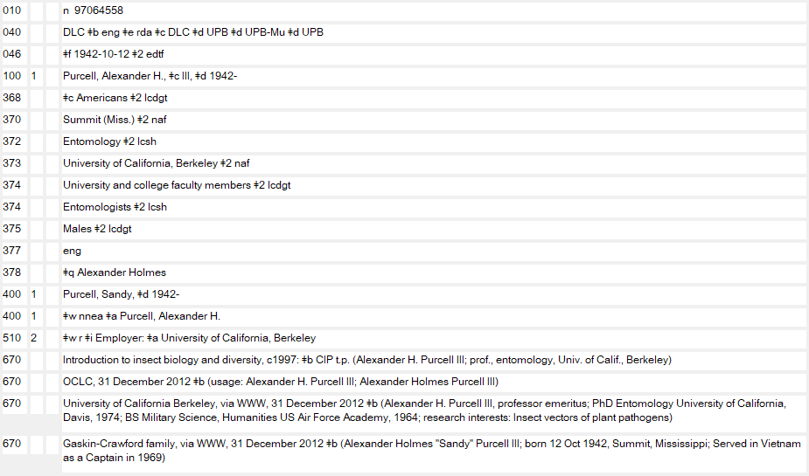
Exercise 4 – Suggested Answer
Module 7. Making Changes to Existing Name and Work/Expression Authority Records
Notes:
October 11, 2024: whited out the 375 field
September 4, 2019: added an additional arrow at first 374 field
The AACR2 heading is not RDA-acceptable! The relationship term III is considered part of the RDA preferred name (RDA 9.2.2.9.5). Note that once an authorized access point is found to be in error (this time because it is not RDA-acceptable), the cataloger establishes the AAP as though for the first time, so here the cataloger added the birth year as well as the relationship term III.
The cataloger chose not to include a 670 field for the work in hand because it didn’t add anything to the information found in other sources recorded in new 670 fields.
It has not been decided (as or March 2013) whether the “RDA-acceptable” AACR2 headings in the LC/NACO Authority File will remain coded AACR2, or whether machine changes will result in all of the RDA-acceptable AACR2 headings being re-coded to RDA.
The thing to remember is this: do not assume that an AACR2 record that does not include a 667 note:
THIS 1XX FIELD CANNOT BE USED UNDER RDA UNTIL THIS RECORD HAS BEEN REVIEWED AND/OR UPDATED
is truly acceptable under RDA. You need to evaluate the usages identified in the 670 fields and make a determination. In this case, the RDA authorized access point is different from the AACR2 heading.
Would you report BFM? (Answer: not necessary since the change is a 1:1.)

Slide 42
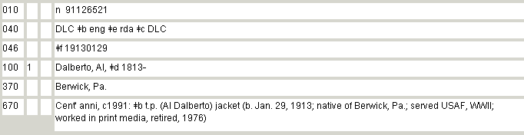
Exercise 5
New resource in hand:
Module 7. Making Changes to Existing Name and Work/Expression Authority Records
Notes:
Updated April 5, 2018: renumbered
Look closely at this record and see if you can determine the error. A new resource is generating the addition of a variant access point and the addition of some newly-identified attributes for the person.

Slide 43
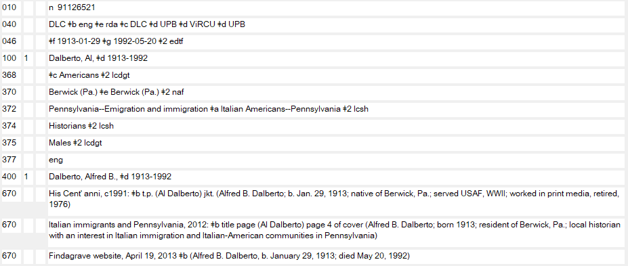
Exercise 5 – Suggested Answer
Module 7. Making Changes to Existing Name and Work/Expression Authority Records
Notes:
October 11, 2024: whited out gender field instead
May 16, 2024: blacked out gender field
March 7, 2019: record updated
A simple typo on the part of the cataloger who created this record resulted in the wrong date of birth being added to the authorized access point. Even the cataloger who evaluated and re-coded the original AACR2 heading to RDA missed the typo.
There is no indication at all that this person was born in 1813, and no justification for that date. It is an obvious error in fact. The authorized access point needs to change.
Since the Find a Grave website was searched, and a death date was located there, the death date was added to the authorized access point and the variant access point: the authorized access point was “egregiously” incorrect on account of the error in the birth year, so since the error was detected and the authorized access point was corrected (i.e., changed), the newly-identified death date was added. Even if the birth year had been correct, since it was an “open” birth year, and a death date was identified, the authorized access point could have been updated to add the death date, even if there were no other changes being made to the authorized access point. This has always been a PCC NACO exception to the principle of only changing an existing authorized access point if it is egregiously incorrect, or in cases of conflict.
Would you report any BFM? (Answer: not necessary since the change is a 1:1.)

Slide 44
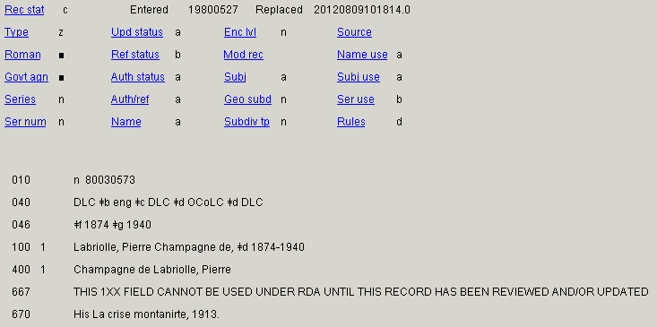
Exercise 6
New resource in hand:
New resource in hand:
Module 7. Making Changes to Existing Name and Work/Expression Authority Records
Notes:
Updated April 5, 2018: renumbered
You are seeing more of this record--the fixed fields--for a reason. Why was this record marked with a 667 note? It does not include any element in the 1XX that is not acceptable under RDA.

Slide 45
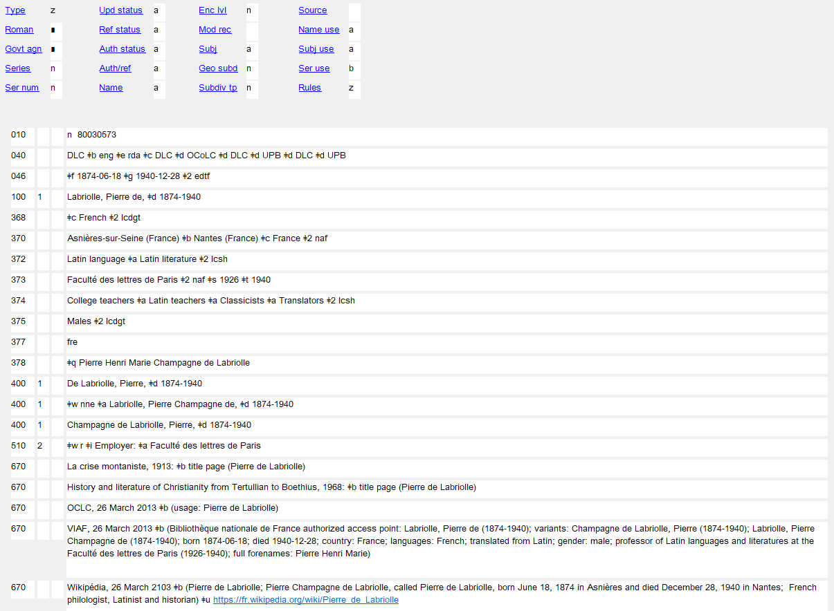
Exercise 6 – Suggested Answer
Notes:
October 11, 2024: whited out gender field instead
May 16, 2024: blacked out gender field
Updated December 17, 2019: moved $w nne in 400 and $w r in 510 to front; added Wikipedia citation and 368 and 370 fields; revised 374 and fourth 670
The record was coded AACR2-compatible! All AACR2-compatible authority records were marked with 667 notes for evaluation before re-coding to RDA. Also note that the Ref status was coded “b”– unevaluated references. Now that you have evaluated and recoded the entire record, including the references, that Ref status can be changed to “a”.

Slide 46
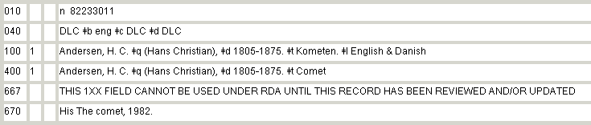
Exercise 7
New resource in hand:
Module 7. Making Changes to Existing Name and Work/Expression Authority Records
Notes:
Updated April 5, 2018: renumbered

Slide 47
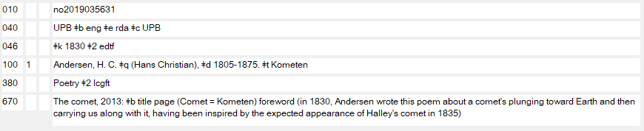
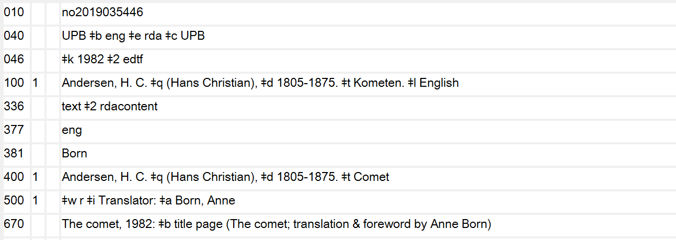
Exercise 7 – Suggested Answer
Module 7. Making Changes to Existing Name and Work/Expression Authority Records
Notes:
Updated December 18, 2019: added speaker notes about 4XX from earlier established form
The AACR2 heading containing two languages needs to be canceled in favor of two separate RDA authorized access points, one for each language. See Summary of Programmatic Changes to the LC/NACO Authority File: What LC-PCC RDA Catalogers need to know (http://www.loc.gov/aba/rda/pdf/lcnaf_rdaphase.pdf).
The original language Danish is not added to the authorized access point for that Expression– the Work record covers that expression under LC practice (for now, at least -- policies may change over time). As discussed in the previous module on works and expressions, PCC catalogers may follow LC practice, or may create a record explicitly for the original-language expression, which would include the language in subfield $l and possibly other elements, if they desire or they feel that their users need the specificity. This slide follows LC practice.
BFM is required since there is an authority delete involved.
Note: When LC cancels the AACR2 record, they will add a 4XX from the AACR2 form (with $w nnea) to each of the new RDA authorities. For example:
100 1 McCormick, Lisa Wade, $d 1961- $t Bigfoot
400 1 $w nnea $a McCormick, Lisa Wade, $d 1961- $t Bigfoot. $l Spanish & English
670 McCormick, Lisa Wade. Pie grande = Bigfoot, ©2013.
100 1 McCormick, Lisa Wade, $d 1961- $t Bigfoot. $l Spanish
400 1 McCormick, Lisa Wade, $d 1961- $t Pie grande
400 1 $w nnea $a McCormick, Lisa Wade, $d 1961- $t Bigfoot. $l Spanish & English
670 McCormick, Lisa Wade. Pie grande = Bigfoot, ©2013.

Slide 48
Nothing Found, Create NAR
What fields are absolutely required?
What information must be included?
Module 7. Making Changes to Existing Name and Work/Expression Authority Records
Notes:
May 1, 2013
Let’s finish up with a summary of things you should consider when establishing a new RDA NAR. What is the bare minimum of information necessary?

Slide 49
Persons
Preferred name (MARC 100) [CORE]
Birth and/or Death Date associated with the person (MARC 046) [CORE]
Title of the person (MARC 368) [CORE]
Other designation associated with the person (MARC 368) [CORE]
Fuller form of name for the person (MARC 378) [CORE if…]
Module 7. Making Changes to Existing Name and Work/Expression Authority Records
Notes:
Updated February 24, 2014
These are the decisions you need to make as you set up an NAR. For example, for a personal name, it all starts with selecting the preferred name, then you consider other attributes, some of which are required in the authorized access point if available, other not required, and left to cataloger’s judgment.
These are the attributes of a person as given in RDA Chapter 9.
Continues on next slide.

Slide 50
Persons
Period of activity of the person (MARC 046) [CORE if…]
Profession or Occupation (MARC 374) [CORE if…]
Place of birth (MARC 370)
Place of death (MARC 370)
Country associated with the person (MARC 370)
Place of residence (MARC 370)
Address (MARC 371)
Module 7. Making Changes to Existing Name and Work/Expression Authority Records
Notes:
January 23, 2023: remove gender
Updated February 24, 2014
Continues on next slide.

Slide 51
Persons
Affiliation (MARC 373)
Language (MARC 377)
Field of activity (MARC 372)
Biographical information (MARC 678)
Module 7. Making Changes to Existing Name and Work/Expression Authority Records
Notes:
Updated February 24, 2014
Last slide for names of persons.

Slide 52
Families
Name of the family (MARC 100) [CORE]
Type of family (MARC 376) [CORE]
Date associated with the family (MARC 046) [CORE]
Place associated with the family (MARC 370) [CORE if…]
Prominent member of the family (MARC 376) [CORE if…]
Hereditary title (MARC 376)
Family history (MARC 678)
Module 7. Making Changes to Existing Name and Work/Expression Authority Records
Notes:
Updated February 24, 2014
These are the decisions you need to make as you set up an NAR. For example, for a family, it all starts with selecting the preferred name, then you consider other attributes, some of which are required in the authorized access point if available, other not required, and left to cataloger’s judgment.
These are the attributes of a family as given in RDA Chapter 10.

Slide 53
Corporate Bodies
Preferred name (MARC 110/111) [CORE]
Location of conference, etc. (MARC 370) [CORE]
Number of a conference, etc. (MARC 110/111) [CORE]
Other designation (MARC 368) [CORE if…]
Associated institution (MARC 373) [CORE if…]
Module 7. Making Changes to Existing Name and Work/Expression Authority Records
Notes:
Updated February 24, 2014
These are the decisions you need to make as you set up an NAR. For example, for a corporate name, it all starts with selecting the preferred name, then you consider other attributes, some of which are required in the authorized access point if available, other not required, and left to cataloger’s judgment.
These are the attributes of a corporate body as given in RDA Chapter 11.

Slide 54
Corporate Bodies
Date associated with the body (MARC 046) [CORE if…]
Language (MARC 377)
Address (MARC 371)
Field of activity (MARC 372)
Corporate history (MARC 678)
Module 7. Making Changes to Existing Name and Work/Expression Authority Records
Notes:
Updated February 24, 2014
(continued) These are the decisions you need to make as you set up an NAR. For example, for a corporate name, it all starts with selecting the preferred name, then you consider other attributes, some of which are required in the authorized access point if available, other not required, and left to cataloger’s judgment.
These are the attributes of a corporate body as given in RDA Chapter 11.

Slide 55
Places
Name of the place (MARC 151) [CORE]
Identifier for the place (MARC 010) [CORE]
But remember that Place Names as Jurisdictions follow RDA Chapter 11 Corporate Body instructions!
Module 7. Making Changes to Existing Name and Work/Expression Authority Records
Notes:
Updated February 24, 2014
These are the decisions you need to make as you set up an NAR. For example, for a place name, it all starts with selecting the preferred name. It’s fairly easy after that– note that there are only two attributes on the slide.
These are the attributes of a place as given in RDA Chapter 16.

Slide 56
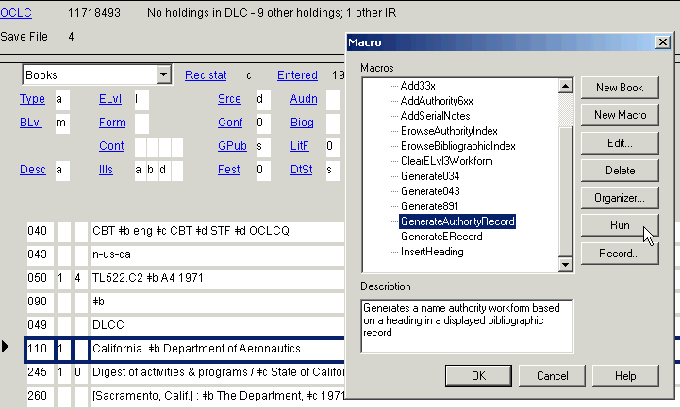
Creating a NEW NAR
NAR access point is highlighted
56
Notes:
May 1, 2013
Did you know about the OCLC Authority Generation macro?
This shows a step in the OCLC Connexion Authority macro process. While viewing a bib record, create a NAR by going to Tools, Macros, Manage, highlight Generating auth. Record, and then Run.
(Note to instructor: Please do a live demonstration of the Authority Generator in OCLC, and the generator in SkyRiver– it is much more helpful to see the generator in action). Also demonstrate how to add a button to the toolbar for the macro, and how to assign a keystroke combination for the macro).

Slide 57
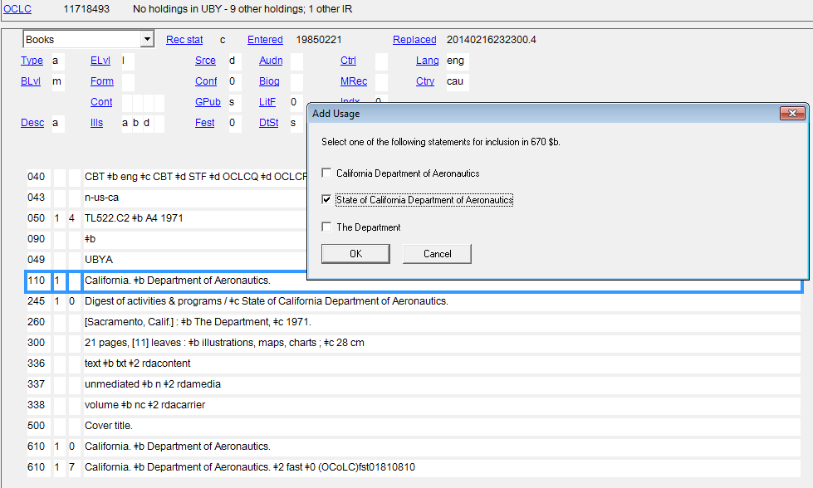
Creating a NEW NAR
57
Notes:
February 24, 2014
The following window usually appears, from which you can chose the language that most closely corresponds to what you want to be recorded in subfield $b of the 670 field. CAUTION: if you move away from the OCLC window this new window may disappear behind the main OCLC window. It is retrievable, but you might not know where it went. You must act on this window (by clicking OK or Cancel) before you can continue.

Slide 58
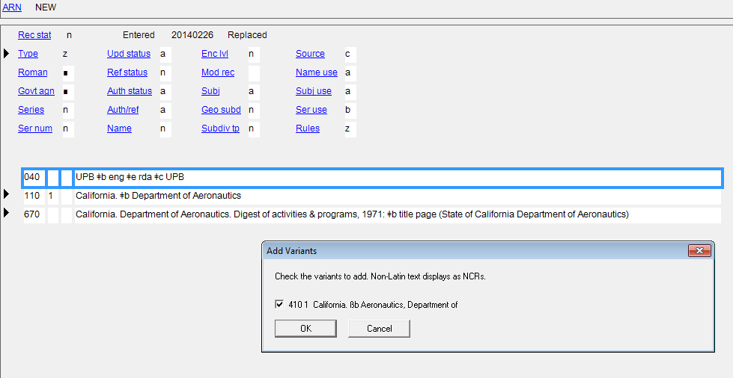
Creating a NEW NAR
58
Notes:
March 8, 2019: speaker notes revised
Next, if the macro program thinks there are possible variants, it may give you a choice here. Either click OK or cancel. In this case “cancel” was chosen because in the cataloger’s judgment the reference was not useful.

Slide 59
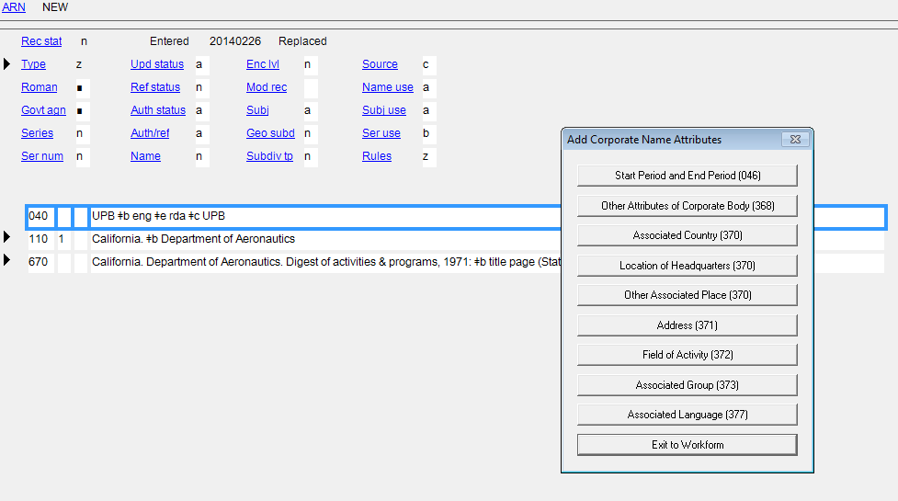
Creating a NEW NAR
59
Notes:
February 24, 2014
Next, you are given the opportunity for assistance adding some of the RDA elements. You can choose any of them you like, or you may find it easier to click “Exit to workform” and add the elements manually. To demonstrate, we will click “Field of activity”

Slide 60
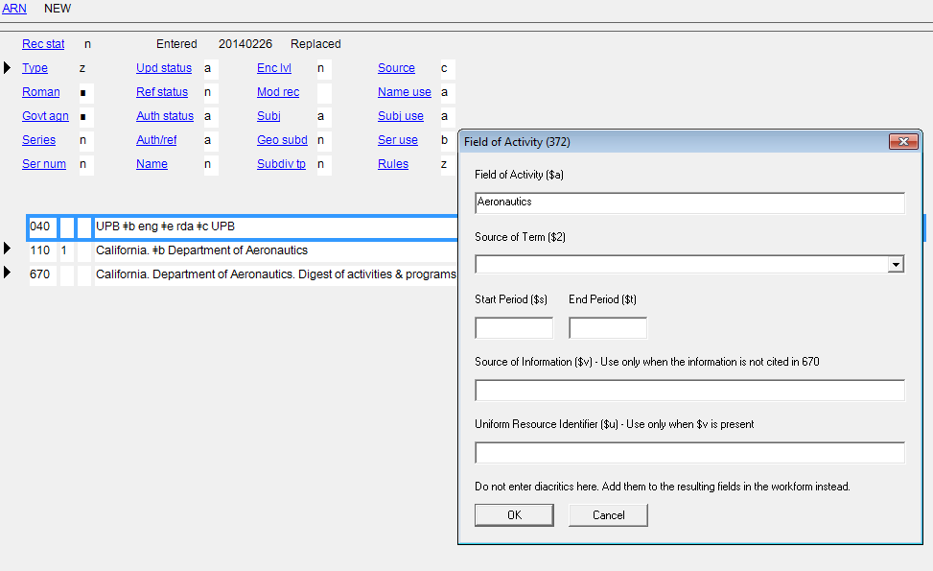
Creating a NEW NAR
60
Notes:
February 24, 2014
I found “Aeronautics” in LCSH, so I copied and pasted the term into the first box.

Slide 61

Creating a NEW NAR
61
Notes:
February 24, 2014
Next, I choose the source of the term.

Slide 62

Creating a NEW NAR
62
Notes:
February 24, 2014
I could optionally fill out the other boxes; then click “OK”.

Slide 63

Creating a NEW NAR
63
Notes:
February 24, 2014
I am given the opportunity to add other elements. In this case, I clicked “exit to workform.”

Slide 64

Creating a NEW NAR
64
Notes:
February 24, 2014
Notice the 372 field has been correctly filled out because of the choices I made on the options window. Again, once you have some experience creating these records, you may find it less cumbersome simply to click “exit to workform” and input 046, 3XX and other fields manually.
NOTE: you still need to check the computer’s work. Don’t assume the computer always gets it right (GIGO=garbage in, garbage out).
For instance, the OCLC macro assumes the 670 information came from the title page, but it actually came from the cover. Please review with caution! Consider whether the location that is given is the correct location for the information recorded and correct if necessary.

Slide 65

Creating a NEW NAR
Fixed fields, 040, 1XX, 3XX, 670 fields input automatically,
some correction required
Module 7. Making Changes to Existing Name and Work/Expression Authority Records
65
Notes:
February 24, 2014

Slide 66

Creating a NEW NAR
Module 7. Making Changes to Existing Name and Work/Expression Authority Records
66
Notes:
May 1, 2013
Of course, you can always create a new NAR by using a blank template.
And you can write “Text Strings” to input common 3XX fields and field combinations, for example, language.

Slide 67

Creating and modifying NARs:
another option
Authority Toolkit
https://files.library.northwestern.edu/public/oclc/
documentation/
Module 7. Making Changes to Existing Name and Work/Expression Authority Records
67
Notes:
September 5, 2019
In addition to the OCLC authority macro, Gary L. Strawn at Northwestern University Library has created a program called the Authority Toolkit. This free software works within OCLC Connexion, and can do many things that the OCLC macro itself cannot. It can:
create a new authority record from an access field in a bibliographic record, and then help you enhance the preliminary authority record
enhance an existing authority record
extract one identity from an undifferentiated personal name authority record (this task combines the modification of an existing authority record with the creation of a new authority record), and then help you enhance the preliminary authority record for the extracted identity
In OCLC Connexion mode, the tool reads bibliographic and authority records directly from the OCLC Connexion client, and writes new and modified authority records directly to the OCLC Connexion client. This is the mode that most NACO participants will prefer to use.
Many fields in an authority record are, or can be, under some degree of vocabulary control. The toolkit contains features that help you construct such fields, and ensure their accuracy.
Instructions for downloading and setting up the Toolkit and using it in conjunction with OCLC Connexion are found at the link on the slide.

Slide 68


Authority Toolkit: New NAR
Notes:
September 5, 2019
To create a new authority record, start with any OCLC bibliographic record that contains the access point you wish to establish in an authority record.
The toolkit knows how to create an authority record from the following bibliographic fields: 100, 110, 111, 130, 240, 490, 600, 610, 611, 630, 651, 700, 710, 711, 730, 800, 810, 811, 830. If you ask the toolkit to use some other field as the basis for a new authority record, the toolkit will complain, and will not attempt to generate an authority record.
After selecting the access field that will serve as the basis for the new authority 1XX field, activate the toolkit by using a toolbar button or keyboard shortcut, depending on how you have configured Connexion. The toolkit gathers information from the bibliographic record. The toolkit will in some cases immediately show you its proposed new authority record, but in other circumstances the toolkit may first ask for your help in one or more matters it can't decide on its own.
CLICK FOR ANIMATION
On the left panel of the Toolkit window, you can see the rudimentary name authority that has begun being created. On the right side, the bibliographic record is present, which you can use to get additional information for the authority record. For example, this person was a graduate student at the University of Washington. You can grab this information from the bib record to insert as an affiliation in the authority record. (Next slide)

Slide 69

Authority Toolkit: New NAR
Notes:
September 5, 2019
The name of the university in the 502 field of the bib record has been highlighted, and the button beside field 373 has been selected. You can now click on “Add 373” and the affiliation will be added to the authority record.
NEXT SLIDE

Slide 70

Authority Toolkit: New NAR
Notes:
September 5, 2019
Notice that a 373 has been added to the authority record, and the program also attempted to justify the 373 by adding something to the 670 field. If you need to edit any of the fields, you can use the “edit” pulldown from the menu.
You decide you do want to modify the 670 to reflect what actually appears on the title page.
NEXT SLIDE

Slide 71

Authority Toolkit: New NAR
Notes:
September 5, 2019
On the left window, you put your cursor in the 670 field, select Edit from the pulldown menu, and the choose Change 670. That brings up a window that allows you to key in the changes to the 670 field that you’d like to make. Once complete, you click OK, and the 670 is now revised.
NEXT SLIDE

Slide 72

Authority Toolkit: New NAR
Notes:
September 5, 2019
Because the 373 was created from a note field in the bibliographic record, it is not controlled. Since NACO policy is to use established forms from the NAF when available, you want to add $2 naf to the 373 field. You can do this by editing the field the same way as was done for the 670, but there’s also another very neat option available: “Verify”. Put your cursor in the 373 and then choose Verify from the pulldown menu. The program will then look for a match in the NAF and if it finds it, will automatically add the $2.
NEXT SLIDE

Slide 73

Authority Toolkit: New NAR
Notes:
September 5, 2019
Voila! The 373 field is now controlled.
You want to add the language of the person to the record. For that you click the Choices tab on the right window.
NEXT SLIDE

Slide 74

Authority Toolkit: New NAR
Notes:
September 5, 2019
In the 377 Language box, you can select the language(s) you want to include, and click Add 377.
NEXT SLIDE

Slide 75

Authority Toolkit: New NAR
Notes:
September 5, 2019
Voila! The 377 field has been added with the correct language code.
NEXT SLIDE

Slide 76

Authority Toolkit: New NAR
Notes:
September 5, 2019
The Web tab allows the Toolkit to go out and capture information from various web resources, such as LC’s Linked Data Service (id.loc.gov), GeoNames, GNIS, Getty Thesaurus of Geographic Names, Union List of Artist Names, VIAF, Wikidata, and English-language Wikipedia. If there were a Wikipedia page about this person, you could go to it, highlight information on it, and the Toolkit could import it and generate a 670 for it.
In this particular case, the only thing you want to add to your NAR is a field of activity for the person. There are a number of different ways to do it, but we’ll grab the term we want from id.loc.gov.
NEXT SLIDE

Slide 77

Authority Toolkit: New NAR
Notes:
September 5, 2019
You select id.loc.gov in the pulldown box, then click to launch it in a browser. You search for the heading Biology and copy the URL from the browser and paste it in the box at the bottom of the Toolkit. You also click the 372 Field of activity button. You don’t need a second 670, so you unclick the Build 670 button, and then you click “Go.”
NEXT SLIDE

Slide 78

Authority Toolkit: New NAR
Notes:
September 5, 2019
Voila! The program has grabbed the LCSH heading and has include the correct source code in the 372 field.
You’re happy now with the NAR you’ve created, and are ready to add it to the NAF. To do that, click “OK” from the pulldown menu.
NEXT SLIDE

Slide 79

Notes:
September 5, 2019
The Toolkit takes the record you created and writes it into a new authority record in Connexion, and you can now add it to the NAF!
This has been just a quick look at a few of the features of the Authority Toolkit. There are a lot of other things it can do, including verifying controlled vocabulary fields in existing authority records and correcting or adding $2 codes, alerting you to typos, etc. It can grab 7XX fields from bibliographic records and make related entity 5XXs in the authority record you’re creating or modifying. You can store particular notes that you commonly use in 667 field (e.g., if you do a lot of conference access points, you can store the 667 note “See also related access points for individual instances of this conference, which include specific information about the number, date, or place of individual conferences.” You’ll never have to type or copy and paste that note again!

Slide 80
Closing: Don’t Agonize!
The file is dynamic; any cataloger with more information may improve the NAR in the future
Be confident! You’re the expert, with the item in hand
Module 7. Making Changes to Existing Name and Work/Expression Authority Records
Notes:
May 1, 2013
We went through a lot of possible situations you may encounter as a NACO cataloger. The most important thing to remember is:
Do not agonize!
Anything you do can be changed or un-done, if needed. And you can always ask about something, if you are not sure. Check with your local NACO liaison, or e-mail naco@loc.gov. We all have been in starting position at one time or another. There are a lot of understanding and sympathetic helpers in the NACO world.

Slide 81
Thank you!
Cooperation by all partners improves the authority and bibliographic databases!
Module 7. Making Changes to Existing Name and Work/Expression Authority Records
Notes:
May 1, 2013

